Slide 1

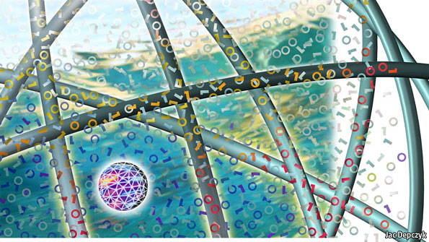
Big Data Analytics Program Using Hadoop Manipal Global Education
An Orientation
28th March 2015, Bangalore 1st batch (Jayanagar)

Slide 2
Table of Contents
Participants Introduction
Faculty Introduction
Big Data Industry Background
Understanding Big Data
Understanding Hadoop
Hadoop Job Mapping
Our Offering
Registration Details

Slide 3
Participants Introduction
Your Name
Your Years of Experience
What do you do in your free time ? (Just to know you better)
Anything else that you would like to add
Your expectations from the course

Slide 4
Faculty Introduction
I’m Syed Rizvi (You can call me Syed)
14 plus years of experience in java, advance java and data processing technologies, mainly at the technical architecture level.
Worked with various multinationals like Deloitte, TCS and MphasiS
Rich expereince in Hadoop Stack (Map Reduce, Pig, Hive etc)
IBM, MongoDB and Hortonworks & IBM Big Data University Hadoop Developer Certified.
Data Science Certified from Coursera
PGDBA – ICFAI Mumbai (Information Technology Major)
PMP Certified from Project Management Institute
Enjoy teaching and sharing knowledge. Taking sessions with many similar organizations
Free Time Escapades - Lawn Tennis, Cycling Trips, Swimming, Guitar, Movies, Watching Cricket

Slide 5
Session’s Context
Big Data Industry
Challenges
Opportunities
Hadoop Job Market
Our Offering

Slide 6


Cricket Match Statistics by ESPN Star Sports
Keys to success for a team
Batsman’s Weak / Strong zone
Bowlers speed, swing and wicket taking delivery graphs

Slide 7

Movie – Citizen Four, on how personal data is compromised
Voice and Internet data being caputured by US - NSA
Analysed for security threats to the nation

Slide 8

Big Data Industry Background – Social Networking
About a billion users
Generates close to 500 TB of data per day
Fires 70 thousand queries on that data every day
Uses Hive as one of the data warehousing solutions over unstrutured data.

Slide 9

Big Data Industry Background – Retail
US$ 485.651 Billion US Retailer
Handles more than a million transactions every day, produces more than 2.5 Petabytes on daily basis.
Has dedicated data centres across the world to handle the above data (Has one in Bangalore too)

Slide 10

Big Data Industry Background – Astronomy
The telescope of Sloans Digital Sky Survey (www.sdss.org/) has accumulated around 140 TB of data in the last decade.
With it’s latest telescope due to come up and running in Chile in 2016, the sky survey team is expected to accumulate 140 TB of data every week !

Slide 11

Big Data Industry Background – Finance
NYSE generates about 1 TB of data new trade data every day to perform stock trading analytics to determine trends for profitable trades

Slide 12
Big Data Industry Background – Other Examples etc
Other Examples
NASA Center for Climate Simulation (NCSS) stores 32 Petabytes of data comprising of climatic obsevations and Simulations.
Large Hadron Collider (LHC) produces 30 GB data every day. Cern Data Center processes 1 GB per day
Success Stories
Big Data Analytics played a large role in Barack Obama’s successful 2012 re-election campaign
It was also in parts responsible for the BJP and it’s allies to win a highly successful Indian General Election 2014
Decoding of Human Genome took 10 years initially to process, now it can be done in less than a day, thanks to Big Data Analytics

Slide 13
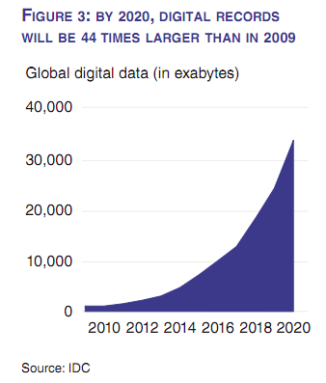
The moral of the story is…there is a splurge of data !
Data is getting accumulated at a breath taking speed.
Should touch 40,000 Exabytes by the year 2020.
As a result, the Big Data Industry is worth $100 Billion growing at 10% annually (Source – The Economist)
The volume exceeds the available storage, hence the need for the organizations to save the data wisely
Big Data / Hadoop tools help you do this, and much much more !

Slide 14
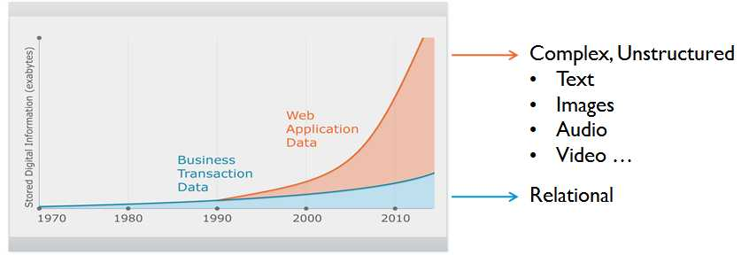
Big Data Industry Background – The reason !
TBD - Put Other examples here.
Till early nineties, the data generated by mainly structured.
From mid nineties onwards, there are had been a surge in unstructured data, mainly through social networking sites like Facebook, Twitter and linked in
We as individuals also generating a lot of data on frequent basis.

Slide 15
Challenges / Opportunities
Challenges
How to save this huge data that is getting accumulated ?
The available technology (read RDBM) is getting obsolete as the data is unstructured.
Opportunities
Exponential increase in the need for experts who have data saving, minning and analysing skills.
“Data is widely available, what is scarce is the ability to extract wisdom out of it”
Hal Varian (Google’s Chief Ecnomist)
“We should be worried about how to train the next generation to make sense out of this data ”
Alex Szalay (Astrophysicist at Johns Hopkins University )

Slide 16
What is is Big Data ?
Big data is the term for a collection of data sets so large and complex that it becomes difficult to save & process it using on-hand database management tools or traditional data processing applications (Wikipedia)
IBM also described big data in terms of 3 parameters – Volume (e.g. Tweeter Data to check sentiments and show trends), Velocity (Analyze financial transactional Data to Detect Fraud Quickly) and Variety (Customer Satisfaction using data collected from multiple communication channels i.e. audio, video etc e.g. Tata Sky)

Slide 17

What is Hadoop ?
Apache Hadoop is a framework that allows for the distributed processing of large data sets across clusters of commodity computers using a simple programming model.
It is an Open-source Data Management framework with scale-out storage & distributed processing capabilities.

Slide 18
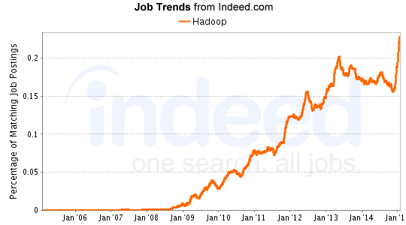
Hadoop Job Mapping

Slide 19
Hadoop Job Mapping (cont)
According to a Gartner report, there will be 4.4 million Big Data / Hadoop jobs created globally by the end of 2015. The skill force available at present is just one third (http://www.gartner.com/newsroom/id/2207915)
All top notch companies have been hiring Hadoop professionals. Currently employing close to 20,000 professionals (Source – Linked In). Then there are start ups too !
There has been a steady increase in demand for Hadoop Professionals in the last few years. It is at its pinnacle at the moment. This is the time to meet that requirement.
Hadoop Architect
Hadoop Tech Lead
Hadoop Module Lead
Hadoop developer

Slide 20

Big Data Analytics Using Hadoop Program (Online/ Blended)
Program Overview:
This is an blended program where you will learn about the entire Hadoop stack at conceptual and technical level. This will include the fundamental concepts of HDFS (Hadoop Distributed File System), Map Reduce and other Hadoop Eco System components
Duration
152 hours (48 hours face to face)
Level of Difficulty
Beginners to Intermediate
Topics Covered
Big Data – An Overview
Hadoop and Its Components
HDFS Architecture
MapReduce Process Flow
Hadoop Installation Modes
Combiners and Partitioners
Pig Execution and Pig Latin
Data Types and Operators
Hive Overview and Hive Architecture
Hive Data Model and HBase Architecture – High Level and Detailed View
Hadoop 2.0 Architecture
YARN MR Execution Flow, Apache Oozie
Assessment
MCQs to ensure concepts have been understood
Project Work
Certification
Certificate from Manipal Global Education
For Whom
Engineering Graduates BSc - IT Graduates, MCA Graduates, PGDBA / MBA Graduates (Information Technology Specialisation)
Professionals wanting to make a career in big data learning and using the Hadoop Framework
Technical Project Managers having 8+ years of experience in the Industry
Data Scientists / Business Analytics / Product Management professionals who want to learn the fundamental Hadoop concepts to enhance their career profile

Slide 21
Program Agenda- 12 Intensive Sessions
Session # | Session Name | Time (min)
Day 1 | Hadoop Concept & Architechture
Session 01 | Big Data Definition | 20
Session 02 | Structured versus Unstructured Data | 20
Session 03 | IBM Definition | 15
Session 04 | Limitations of existing solutions | 30
Session 05 | How Hadoop Addresses These Limitations | 10
Session 06 | Hadoop Definition | 10
Session 07 | Hadoop Ecosystem | 30
Session 08 | Hadoop Components | 30
Session 09 | Anatomy of file read and write | 30
Session 10 | Rack Awareness | 15
Session 11 | Hadoop Architecture | 30
 | Total Mins | 240
Day 2 | Hadoop Configurations
Session 01 | Revision of the previous session | 15
Session 02 | Hadoop Cluster | 30
Session 03 | Hadoop Typical Configuration | 20
Session 04 | Hadoop Modes | 30
Session 05 | Configuration Files | 20
Session 06 | Master verses Slave Nodes | 15
Session 07 | Demo of Configuration Files on the Cluster | 20
Session 08 | Running the Hadoop Word Count Example | 30
Session 09 | Running the Temperature Example | 20
Session 10 | Running HDFS Commands | 40
 | Total Mins | 240
Session # | Session Name | Time (min)
Day 3 | Map Reduce
Session 01 | Revision of the previous session | 15
Session 02 | Industries where Map Reduce / Hadoop is used | 10
Session 03 | Traditional Way of distributed computation | 20
Session 04 | Map Reduce Way | 20
Session 05 | Advantages of Map Reduce | 15
Session 06 | Splits & Blocks | 20
Session 07 | Additional Supporting Concepts - Combiner | 20
Session 08 | Additional Supporting Concepts - Partitioner | 20
Session 09 | Demo of Map Reduce with different input formats | 60
Session 10 | Demo of Combiners | 20
Session 11 | Demo of Partitioners | 30
 | Total Mins | 240
Day 4 | Advance Map Reduce
Session 01 | Revision of the previous session | 15
Session 02 | Joins | 30
Session 03 | Sorting | 30
Session 04 | Standard & Custom Input Formats | 20
Session 05 | Counters | 15
Session 06 | Distributed Cache | 20
Session 07 | Sequence Files | 20
Session 08 | Demo of Map and Reduce Side Joins | 45
Session 09 | Demo of Counters | 15
Session 10 | Demo of Sequence Files | 30
 | Total Mins | 240

Slide 22
Program Agenda (Contd)
Session # | Session Name | Time (min)
Day 5 | Pig & Pig Latin
Session 01 | Revision of the previous session | 15
Session 02 | Need for Pig | 20
Session 03 | When and when not to use it | 20
Session 04 | How it is used at Yahoo | 15
Session 05 | Basic Structure | 20
Session 06 | Data Model | 20
Session 07 | Pig Operators | 30
Session 08 | Word Count in Pig | 20
Session 09 | Max Temperature in Pig | 20
Session 10 | Custom Functions in Pig | 30
Session 11 | Movies Example | 15
 | Total Mins | 240
Day 6 | Hive
Session 01 | Revision of the previous session | 15
Session 02 | How Hive came into picture | 15
Session 03 | Hive Definition | 15
Session 04 | Hive versus pig | 10
Session 05 | Hive Architechture and Components | 20
Session 06 | Hive Limitations | 15
Session 07 | Hive Versus RDBMS | 15
Session 08 | Hive Data Model | 20
Session 09 | Partition & Buckets | 30
Session 10 | Hive Commands | 30
Session 11 | Table Joins | 25
Session 12 | Data Uploads Using SQOOP & Flume | 30
 | Total Mins | 240
Session # | Session Name | Time (min)
Day 7 | Hbase
Session 01 | Revision of the previous session | 15
Session 02 | Need for Hbase | 15
Session 03 | NoSQL World | 20
Session 04 | Hbase Defined | 15
Session 05 | Hbase History | 10
Session 06 | Hbase Versus RDBMS | 15
Session 07 | When and when not to use Hbase | 15
Session 08 | Understanding Hbase better | 20
Session 09 | Hbase Data Model | 15
Session 10 | Hbase Storage Architechture | 15
Session 11 | Hbase Commands | 30
Session 12 | Hive To Hbase | 15
Session 13 | Pig to Hbase | 15
Session 14 | SQOOP & FLUME to Hbase | 25
 | Total Mins | 240
Day 8 | Apache Oozie & Zookeeper
Session 01 | Revision of the previous session | 15
Session 02 | Zookeep Definition | 30
Session 03 | Example Configurations | 30
Session 04 | Oozie Defintion | 30
Session 05 | Example Configuration | 30
Session 06 | Demo of Oozie configured with Pig, Hive and Map Reduce | 45
Session 07 | Demo of Zookeeper configured with Pig, Hive and Map Reduce | 45
Session 08 | SQOOP and FLUME with Oozie | 15
 | Total Mins | 240

Slide 23
Program Agenda (Contd)
Session # | Session Name | Time (min)
Day 9 | Hadoop 2.0
Session 01 | Revision of the previous session | 15
Session 02 | Hadoop 1.0 Challenges | 20
Session 03 | Hadoop 2.0 New Features | 20
Session 04 | Hadoop 2.0 High Availability | 20
Session 05 | Hadoop 2.0 Federation | 20
Session 06 | New Cluster Architechture | 20
Session 07 | Hadoop 2.0 Components | 20
Session 08 | Hadoop 2.0 Map Reduce Flow | 30
Session 09 | Map Reduce Example in 2.0 | 30
Session 10 | Pig Example in 2.0 | 15
Session 11 | Hive Example in 2.0 | 15
Session 12 | Hbase Example in 2.0 | 15
 | Total Mins | 240
Day 10 | Visualization Tools - I (R Language)
Session 01 | Revision of the previous session | 15
Session 02 | R as a Data Visualization Language | 30
Session 03 | R Studio | 15
Session 04 | Obtaining Data with R | 60
Session 05 | Plotting Data with R | 60
Session 06 | Simple R Data Reading and Writing Examples | 30
Session 07 | Examples of Data Plotting with R | 30
 | Total Mins | 240
Session # | Session Name | Time (min)
Day 11 | Visualization Tools - B (Mahout etc)
Session 01 | Revision of the previous session | 15
Session 02 | Mahout Definition and Components | 60
Session 03 | Pentaho Definition and Components | 60
Session 04 | Demo of Mahout | 60
Session 05 | Demo of Pentaho | 60
Session 06 | Total Mins | 240
Day 12 | Project Work
Session 01 | Explain the Use Cases Available | 60
Session 02 | Explain the Project Completion Proccess | 60
Session 03 | Explaing a suggested / sample implementation | 60
Session 04 | Queries / Suggestions | 60
 | Total Hours | 240

Slide 24
Registration Process
Online Registration Process
http://apply.manipalglobal.com/nrapp/faces/index.jsp
Registrations close on 4th Of April 2015

